Slide 2
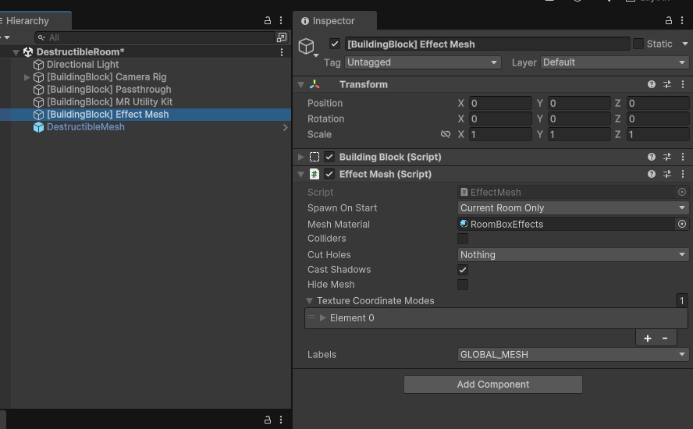
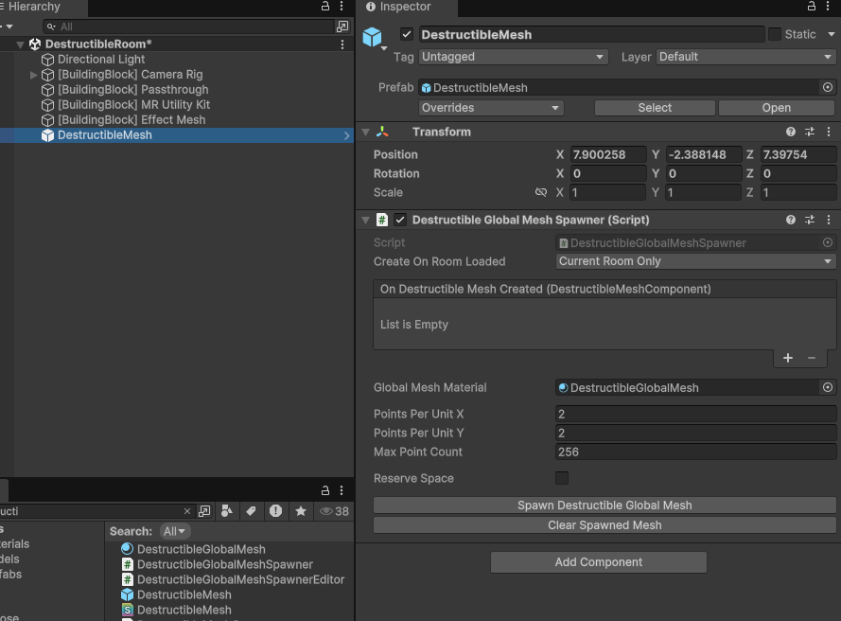
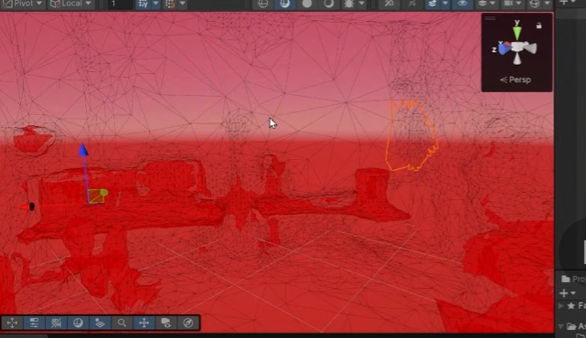
effect mesh VS destructiable mesh, latter one can be broken into pieces， these are the key points to “destroy effect”

Slide 3
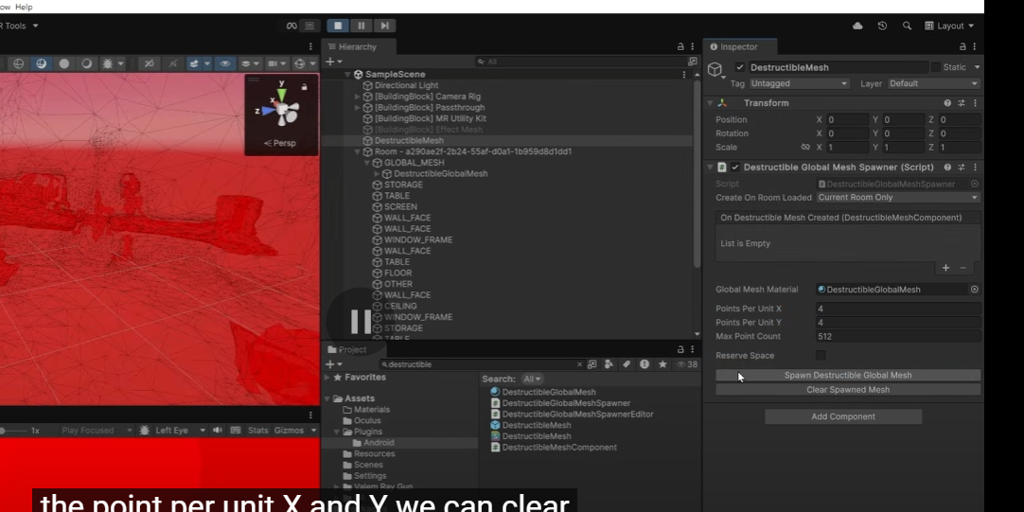
change resolution of spwaned room mesh, remember to clear and regenerate it after change the varieables

Slide 4
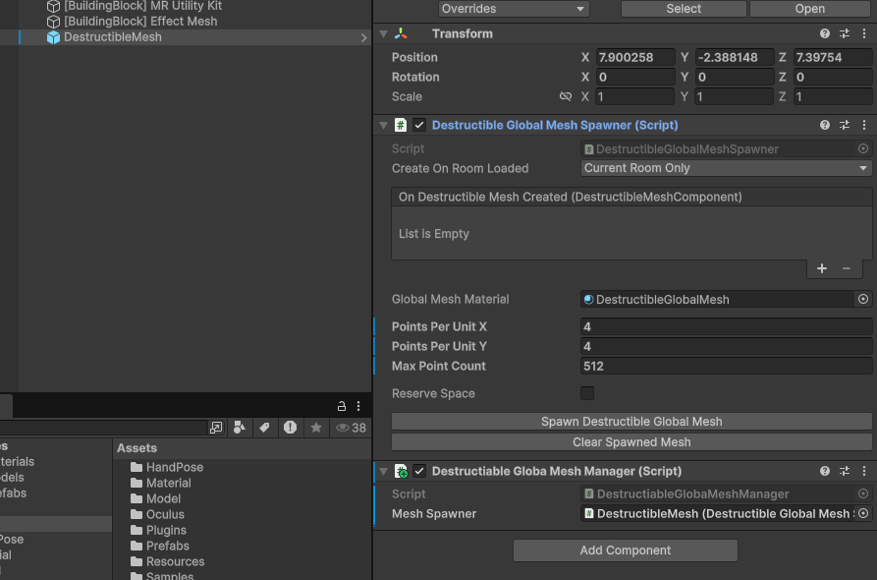
add destrutiable..to script

Slide 5
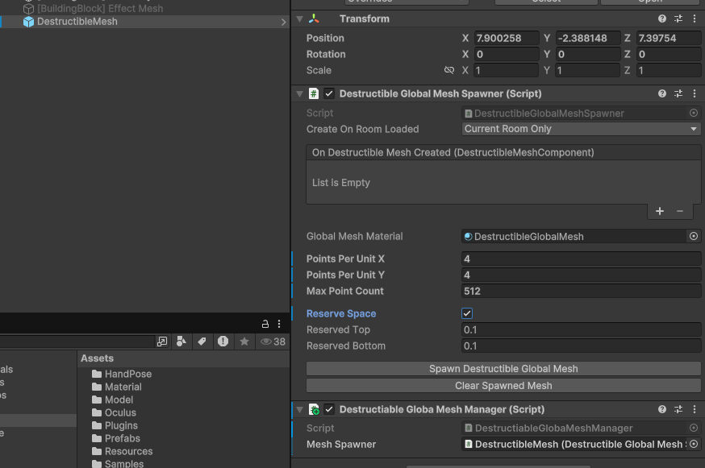
add Reserve space: Celling and floor which cannot be destroyed in game

Slide 6
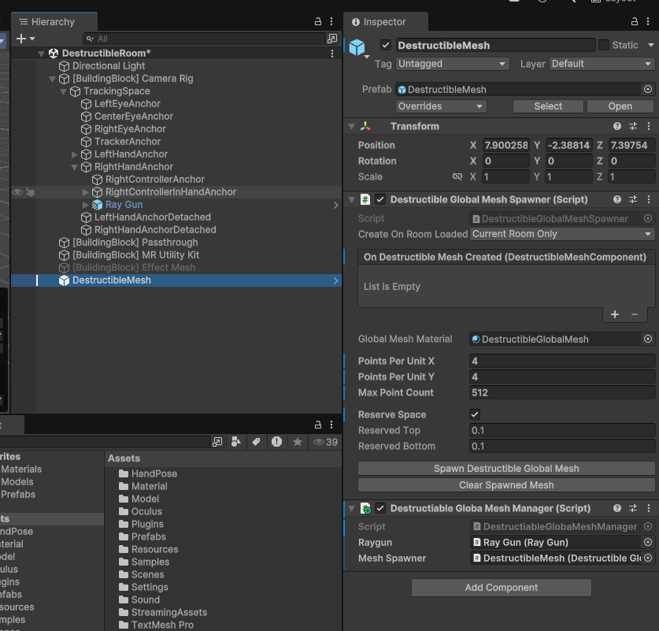
add Raygun to right anchor and Scripts

Slide 7
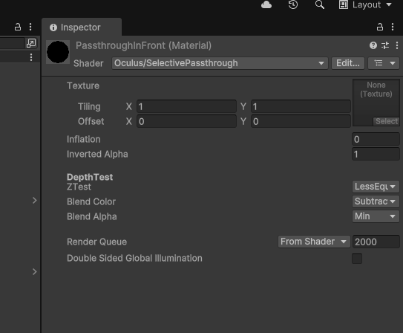
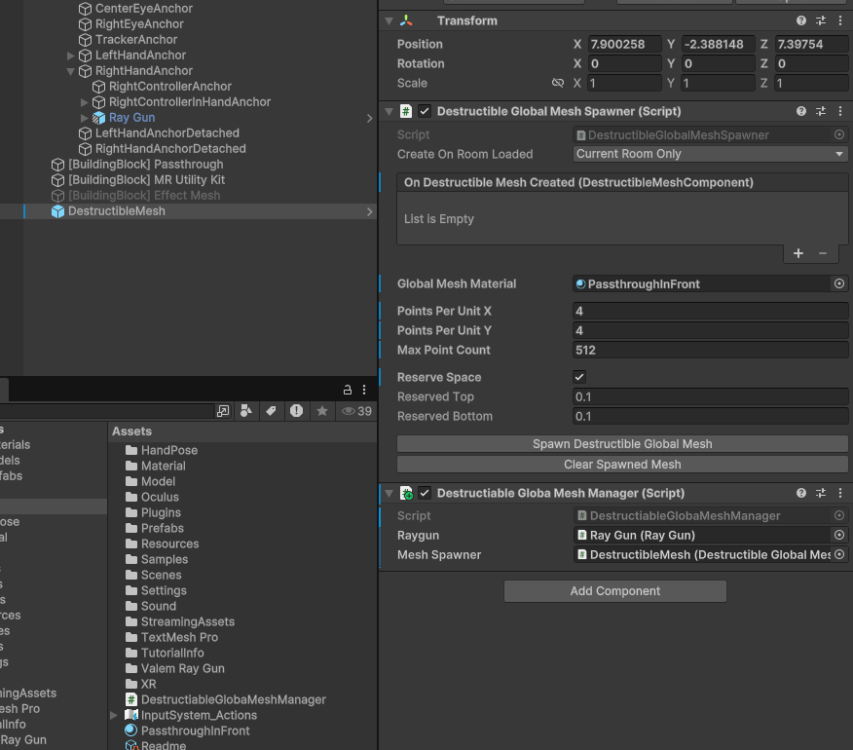
Create a material and set its shader to selectivePassthrough Set blend color to substract, and add this material to DestructiableMesh

Slide 8
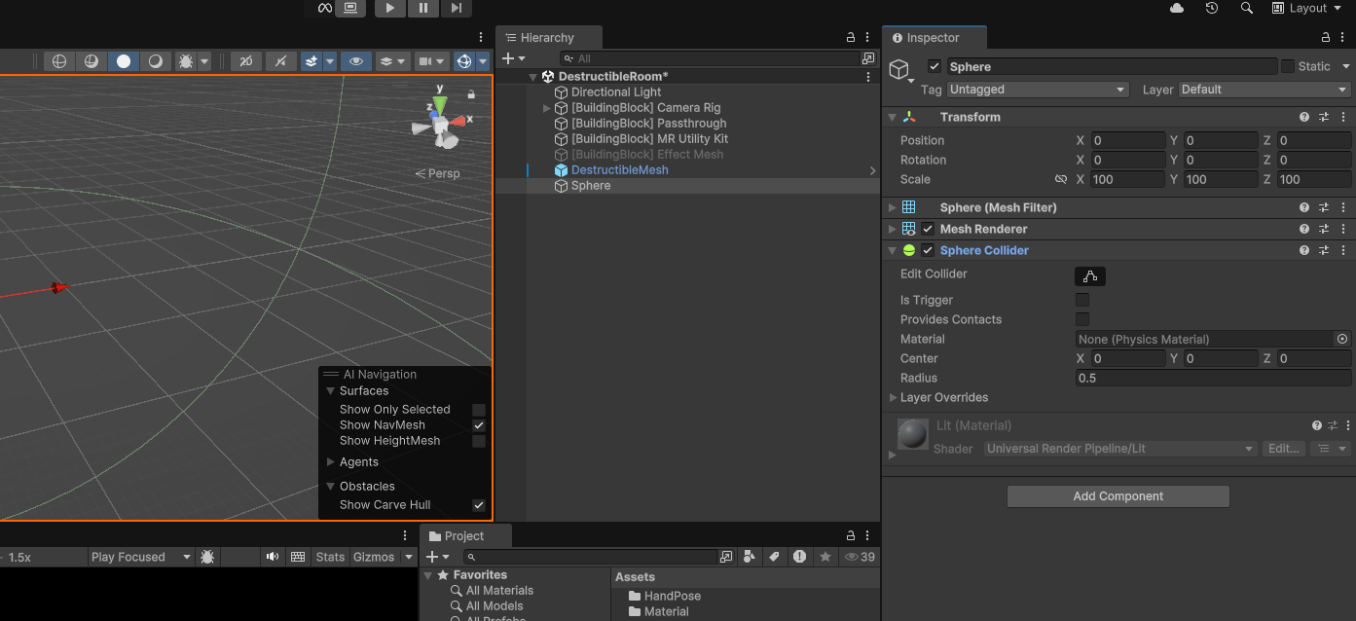
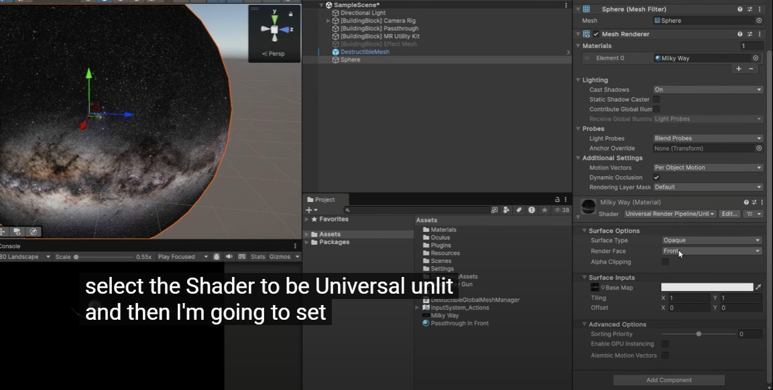
add sphere as outside environment, remove sphere collider,then drag 360° photo texture as material and set it to urp-unlit

Slide 9
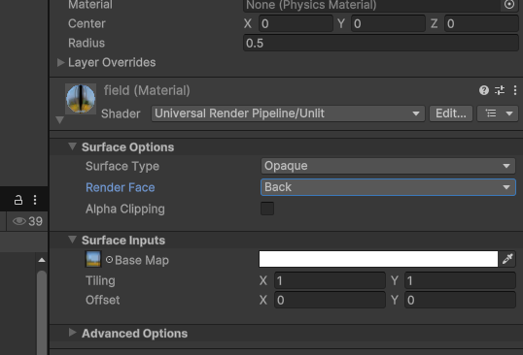
set render face to back so that it shows on inner sphere

